Slide 1

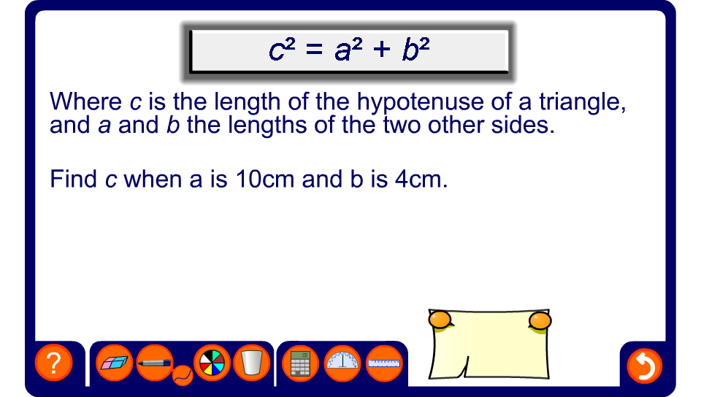


Substituting into formulae

